Slide 1

Automation Overview

Slide 2
Contents
What is Automation?
Why Automation?
Types of Automation
Impact of Automation
How we do?
Project Flow
Tech Stack
Sources
Value Proposition
Use Cases
Pricing Model

Slide 3
What is Automation?
Automation (AKA) Robotic Process Automation uses technology to automate complex business processes. It is designed to remove bottlenecks, reduce errors and loss of data, all while increasing transparency, communication across departments, and speed of processing.
At Red Sky Health, We build scalable & efficient BOTs through Open-source technologies which eliminates the Licensing Cost and thus saving your Bot Development Cost.

Slide 4






Why Automation?
Productivity
Consistency
Can execute 10X faster than any human could.
Follow rules 100% of the time.
Accuracy
Compliance
Do not make errors or get tired.
Have security features to guarantee IT Complaince.
Reliability
Employee Morale
Always own. You never have to worry about a Sick day.
Allow employees to focus on more strategic tasks.

Slide 5
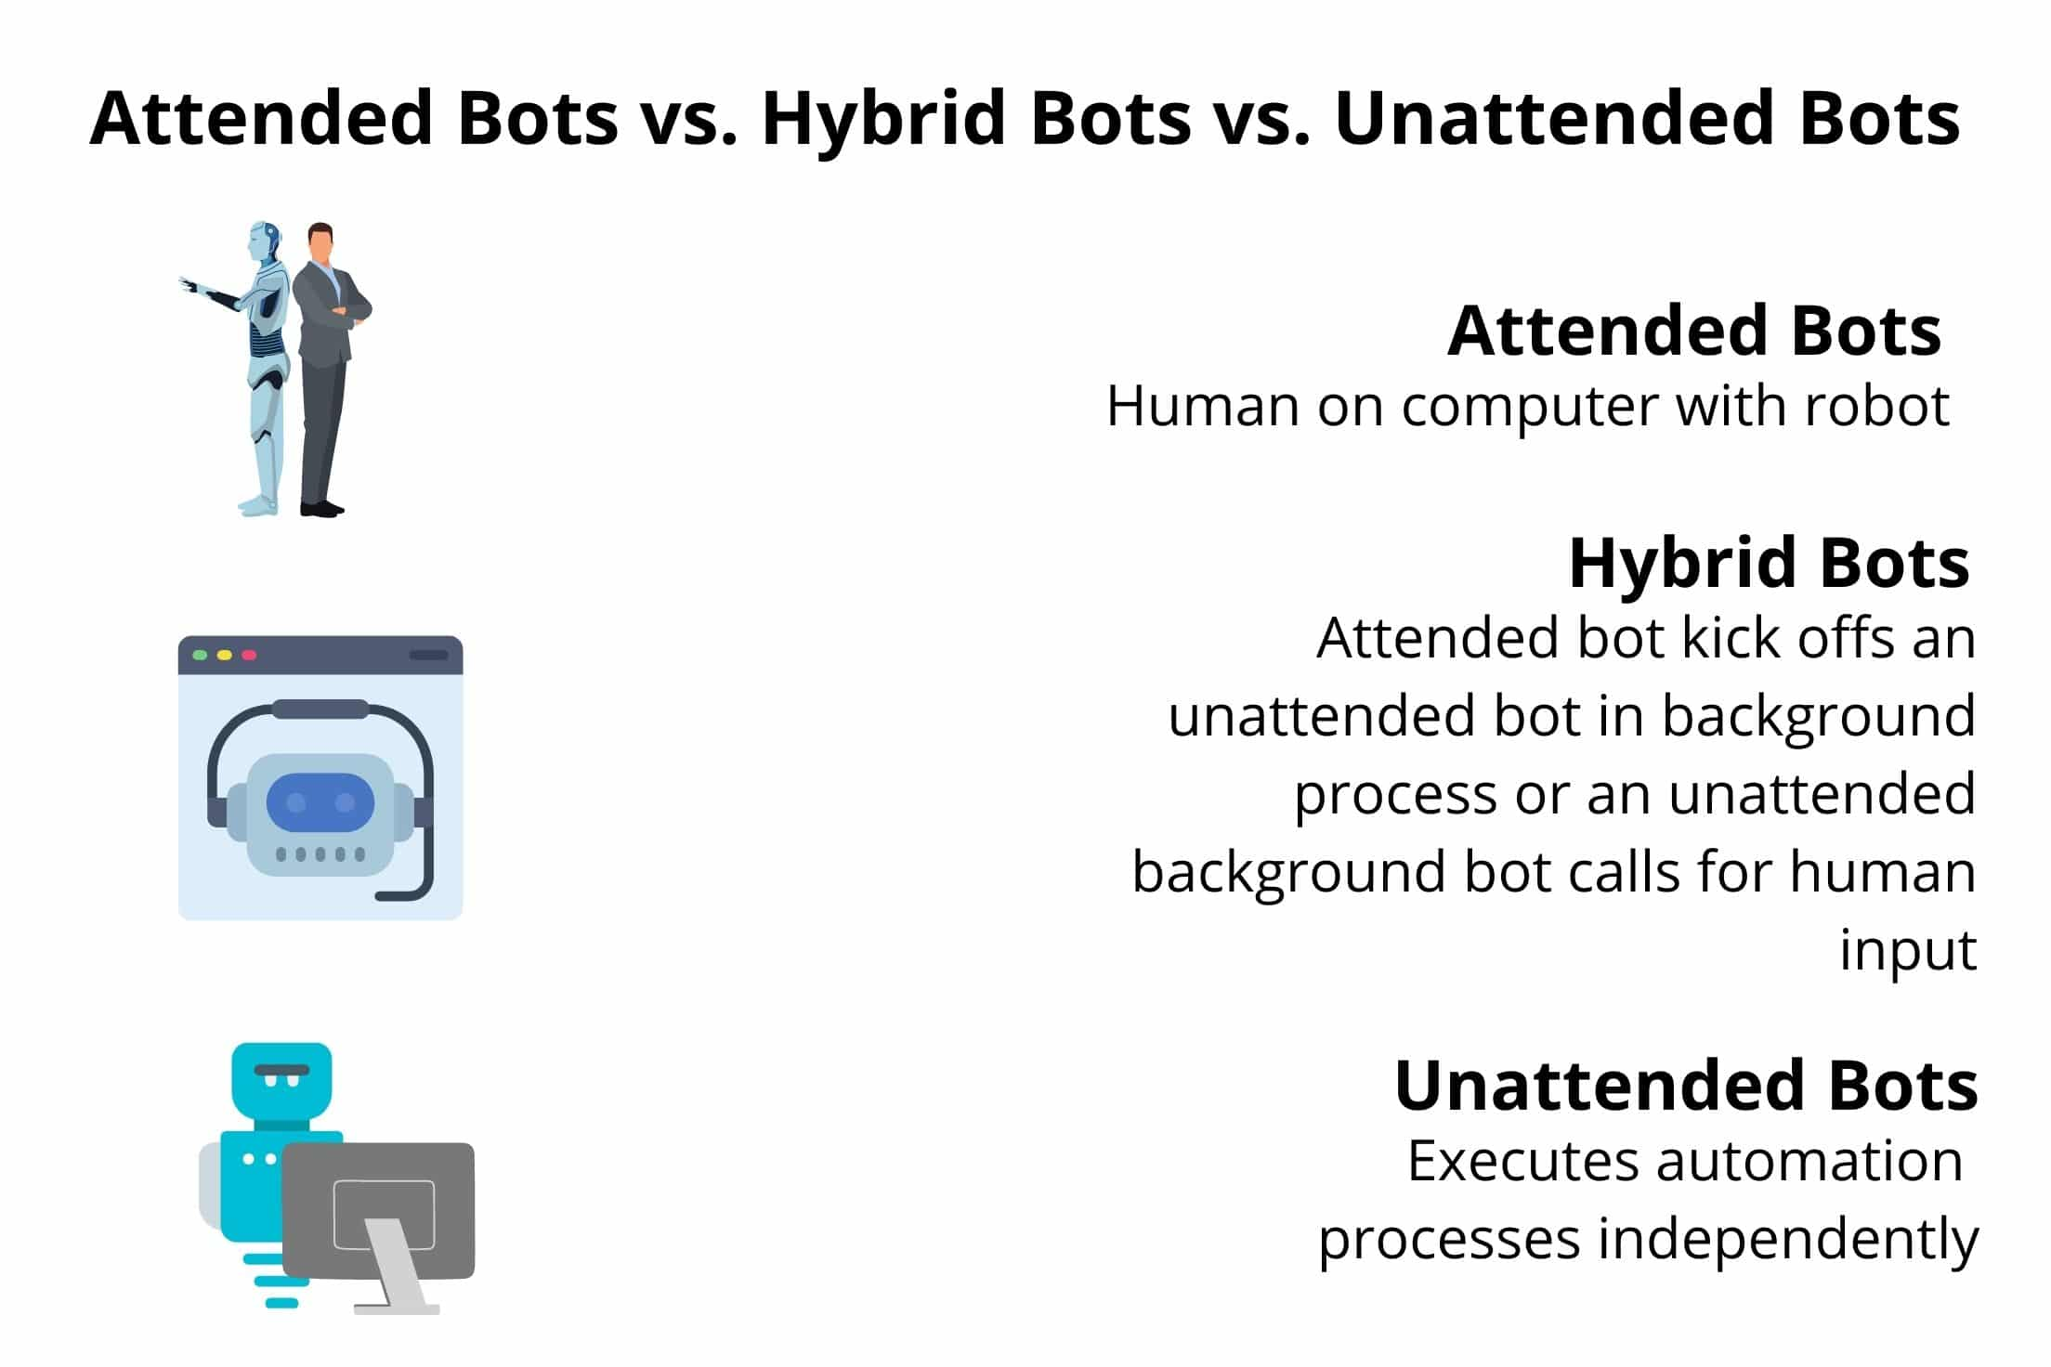
Types of Automation
Attended BOT
Partially automates process, where robots are co-working with humans
Automates a part process, assists users
Deployed on user workstations
Triggered by User
Hybrid BOT
Attended BOT kicks off an Unattended Bot in the background process
Unattended BOT might get input from an Human
Not Schedule based, But it executes based on Trigger
Unattended BOT
Fully automated process, where robots are working autonomously with human supervision
Deployed on Servers or Virtual Workstations
Schedule based or trigger based

Slide 6
Impact of Automation
Optimizing Operational Efficiency
Cost
Reduction
Competitive Advantage
Enhanced
Processes
Optimizing
KPIs
Rapid
ROI

Slide 7
How we do?
Roadmap/Project Plan would be defined at the initiation of the Project.
Bugs & Enhancements (Change Requests) would be tracked until the project is delivered.

Slide 8
Project Flow
Project Management
Develop & Maintain
Project Initiation
Assign Developers
Get Knowledge Transfer
Develop & Test
Deploy
Track & Monitor
A Jira board would be created at the beginning of the Project to see a real-time update of the project.

Slide 9


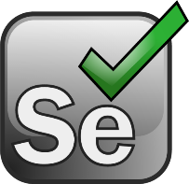




Tech Stack
Project Management
Development
Deployment
RPA helps us to automate our everyday repetitive duties.
RPA provides us with a virtual employee that can execute repetitive tasks more quickly and cost-effectively than people.
With some of the top Open-Source Tools on the market, RPA has truly altered the game.

Slide 10







Sources
Local Desktop
Activities which involves within the Local Network (MBW)
Excel, Desktop or Shared Drives
Citrix/VMWare
Activities which involves Citrix but not RDC
Applications opened via Citrix
RDC
Activities which involves RDC but not Local Network (MBW)
Opening RDC and accessing Apps
Web Apps/Sites
Activities which involves Web Applications/Sites
Can be accessed from Local Network

Slide 11
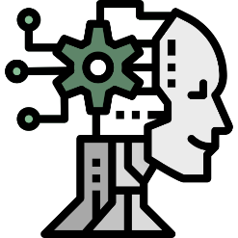
Value Proposition
ROBUST FIVE-STEP PROCESS TO IDENTIFY, DEVELOP AND DELIVER BOTS
Analyst Bots
Document the as-is process
Functional/ non-functional requirements
Identify opportunity and assess the feasibility
Prepare the business case
KEEN FOCUS ON AUTOMATION DEVELOPMENT
Perform production tasks
Evaluate
Document
Auditor Bots
Perform quality audit functions
Performance monitoring
Training/ handover to Client
Orchestrate
Value stream mapping
Process definition document/ To be process
Ideate
Supervisor Bots
Assist leaders in reporting and allocation tasks
Automate
Bot development
User acceptance testing (UAT) and Go-live

Slide 12
General - Use Cases
Excel Automation
Word Automation
Mail Merge
Document Generation
Document Conversion
Content Extraction
Document Distribution
Form Creation
Document Templates
Custom Macro
Data Import/Export
Data Cleaning/Transformation
Data Analytics/Reporting
Bulk Email Notifications
Expense Tracking/Budgeting
Employee Onboarding/Payroll
Project Management
Financial Modeling/Forecasting
PDF Automation
Browser Automation
PDF Generation
PDF Conversion
PDF Merging/Splitting
Data Extraction
PDF Form-filling
PDF Bookmarking
PDF Hyperlinking
OCR/Text Recognition
Web Scraping/Data Extraction
Form Filling/Submission
Web Navigation/Interaction
Data Validation/Verification
Data Upload/Download
Data Entry
Web Screen Capturing

Slide 13
RCM - Use Cases
Medical Coding
Accounts Receivable
PDF Categorization
PDF/MR Download
EMR Coding
Coding Audit
Open AR & Rejections
Claim Status Check
Eligibility Check
Appeal Packet Preparation
Charge Posting
Refunds
Face Sheet Recognition
Demo Entry
EMR Charge Entry
Charge Audit
Insurance Refund Packets
Patient Refund Packets
Refund Log
Transaction Audit
Payment Posting
Other Tasks
ERA Posting
Manual Posting
Reconciliation Log
Transaction Audit
Time Tracking Tool
PDF/Image Recognition
Doc Download/Upload

Slide 14

Pricing Model
Build & Ship
Build & Deploy
Build & Maintain
We would Develop, Test & Ship it to you.
We would Develop, Test & Deploy it in your environment.
We would Develop, Test & Maintain it.
Manual-execution
Auto-execution
Auto-execution
Up-to 5 Changes
Up-to 5 Changes
Up-to 5 Changes
Sent via SFTP/Secured Mail
Deployed in your Environment
Deployed in your Environment
No Maintenance
No Maintenance
100% Maintained

Slide 15
Thanks!
Contact Us today to get your Free No Obligation Quote

